Slide 1
Free Issue Personal Protective Equipment (PPE) for COVID Mitigation

Slide 2
General Information
New initiative to provide PPE free of charge to eligible entities to reduce spread of COVID or other infectious diseases
Recipient entities may be responsible for transportation of the items from the Central Services Warehouse in Urbandale, Iowa
Items are available while existing supplies last
Eligible entities include a very broad range state agencies, cities, counties, schools, hospitals, clinics, long-term care facilities and congregate housing, non-profits, affected businesses, etc.
Everything will be issued in case quantities only
Warehouse POC to coordinate issue – rick.tucker@iowa.gov - 515-360-9912

Slide 3
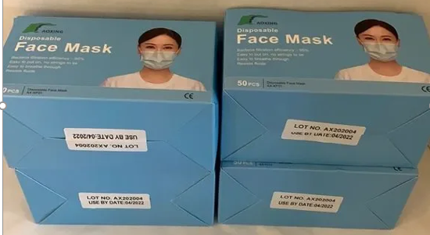
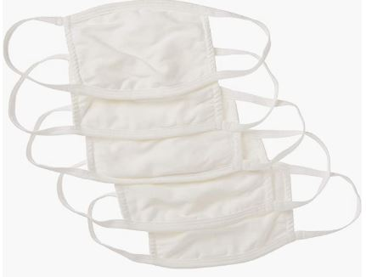
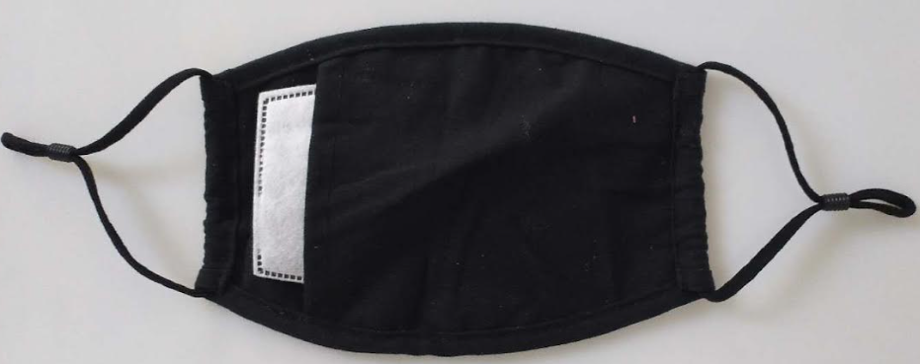
Disposable or Cloth Face Masks
Disposable masks are past their use by date, so not authorized for use in a medical setting, but will still serve the purpose of reducing spread of airborne viruses
Cloth masks - We offer a variety

Slide 4
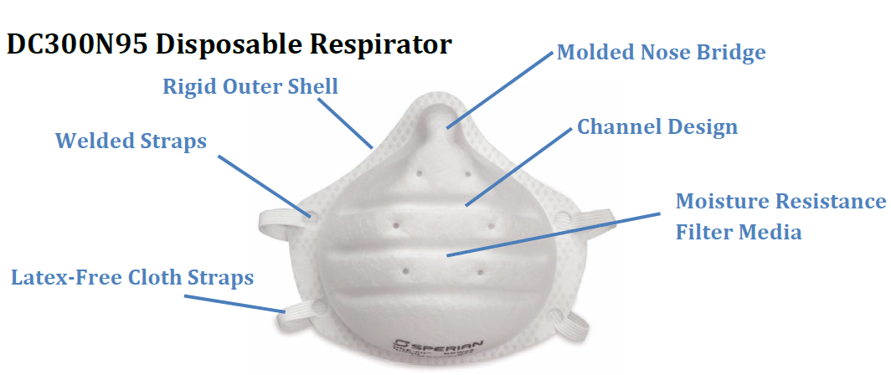
N95 and KN95 Respirators
N95 and KN95 Respirators are more effective than disposable masks or cloth masks, and have a longer shelf-life than disposable masks

Slide 5
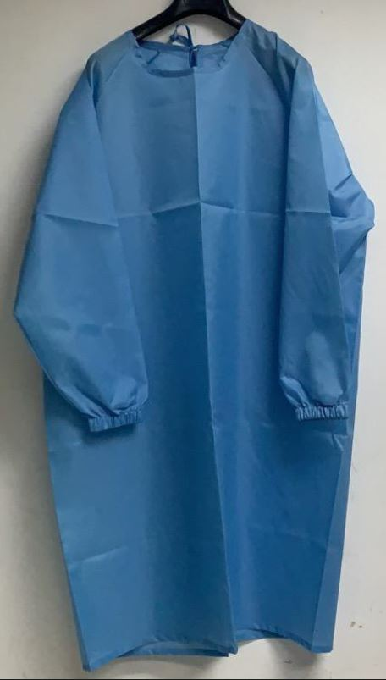
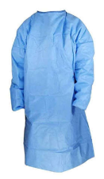
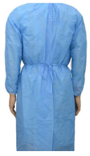
Reusable Cloth & Disposable Gowns
We offer a variety of reusable cloth gowns, AAMI Level 2 in sizes S, M, L, XL, and XXL, AAMI Level 1 unisize, and non-tested in a variety of sizes.
We also have a variety of disposable gowns, AAMI Level 3 in sizes S, M, L, XL, and XXL, or unisize.

Slide 6
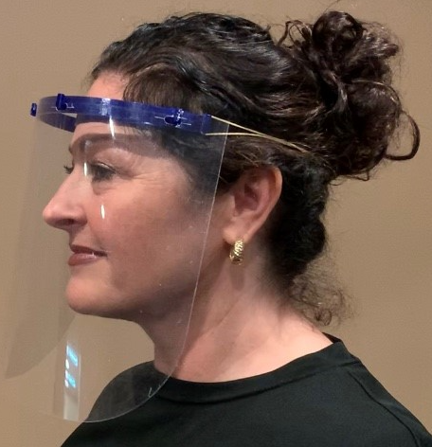
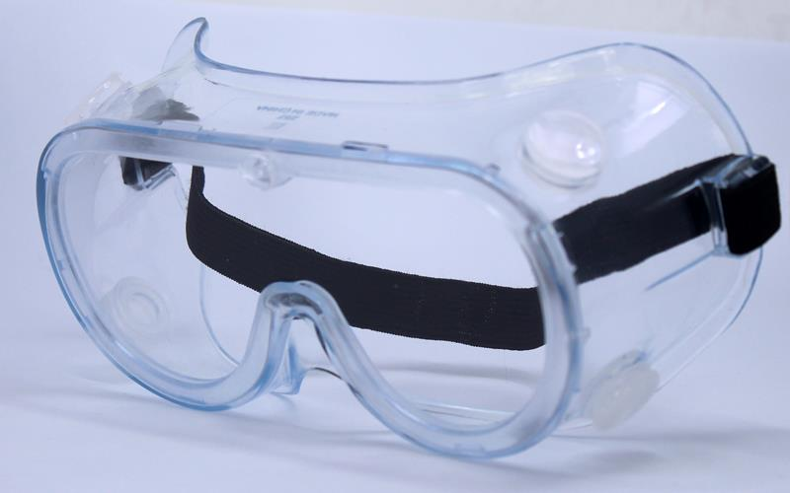
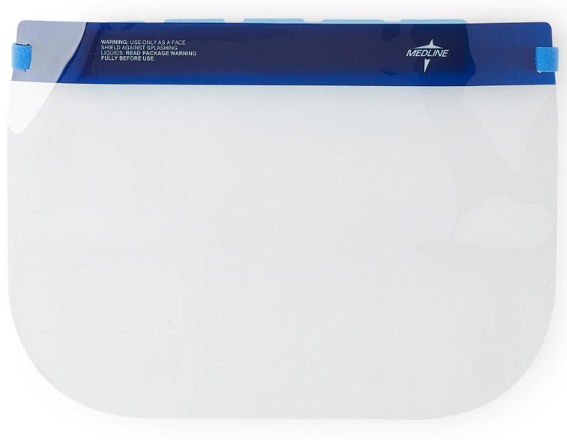
Goggles & Face shields
We have vented goggles, and a variety of face shields

Slide 7
Additional information
A limited supply of hand sanitizer and surface disinfectant is also available
Ventilators are available for long-term loan under a memorandum of understanding with the eligible entity.
Email allen.meyer@iowa.gov, or call 515-725-2272 for more information on the ventilator loan process.

